Slide 1
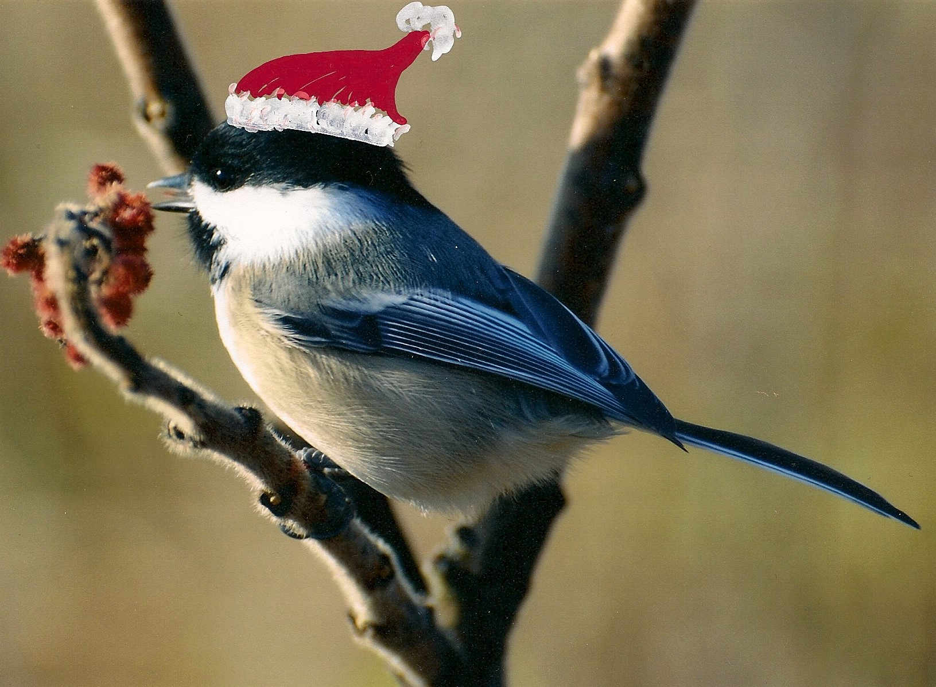
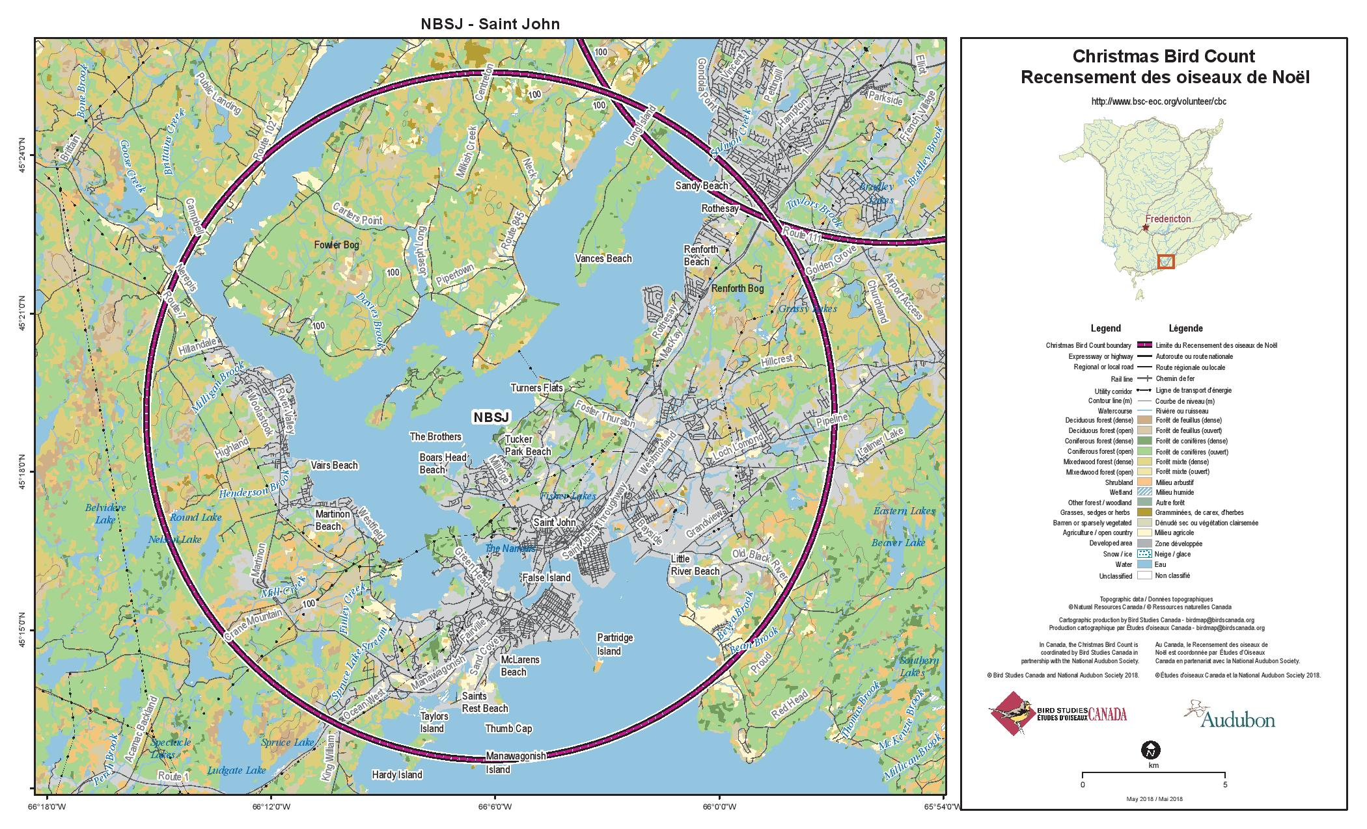
70 years of Saint John Christmas Bird Count data now available in digital form suitable for analysis

Slide 2
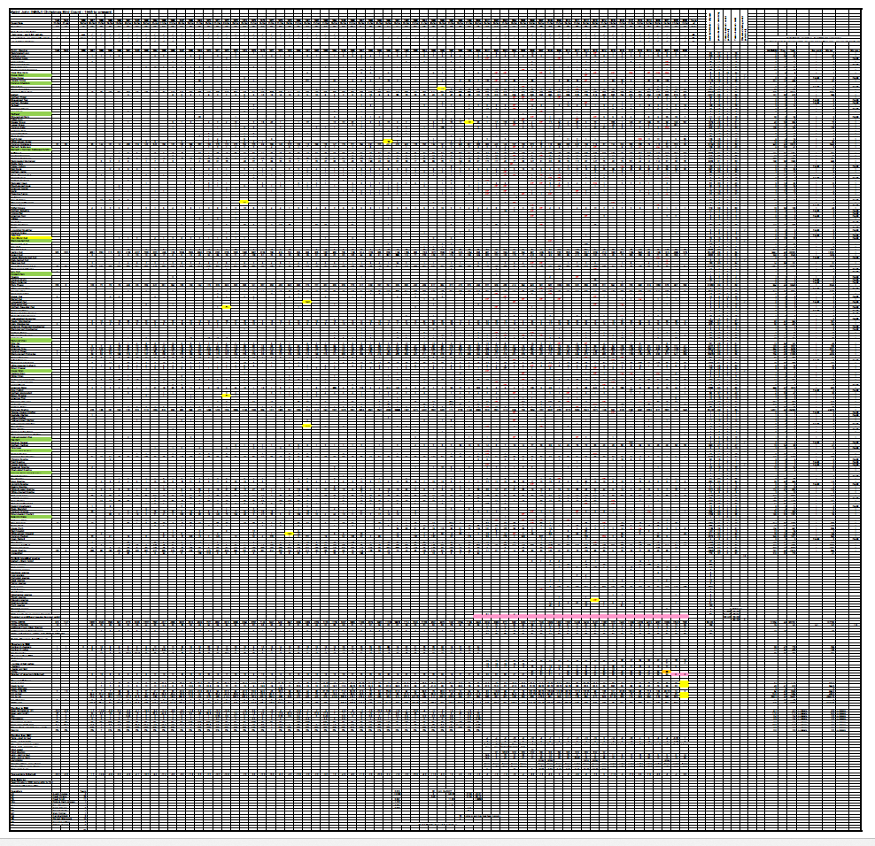
The Starting Point:
David Christie’s spreadsheet (1945-2000)
100 columns by 250 rows

Slide 3
More slides to come
Background
Instructions
Graphs

