Slide 1
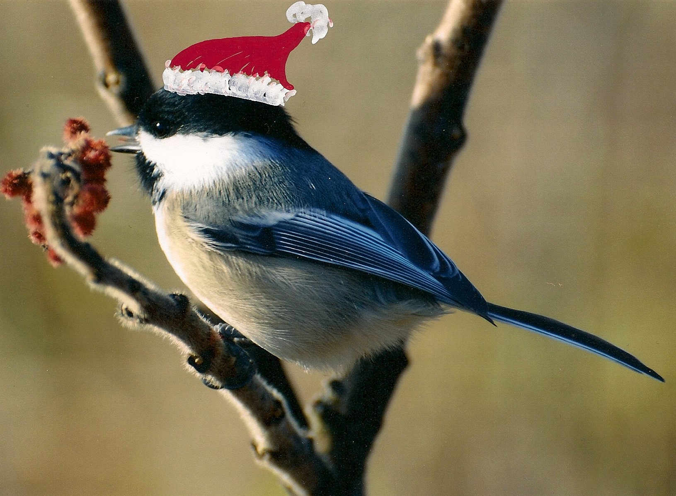
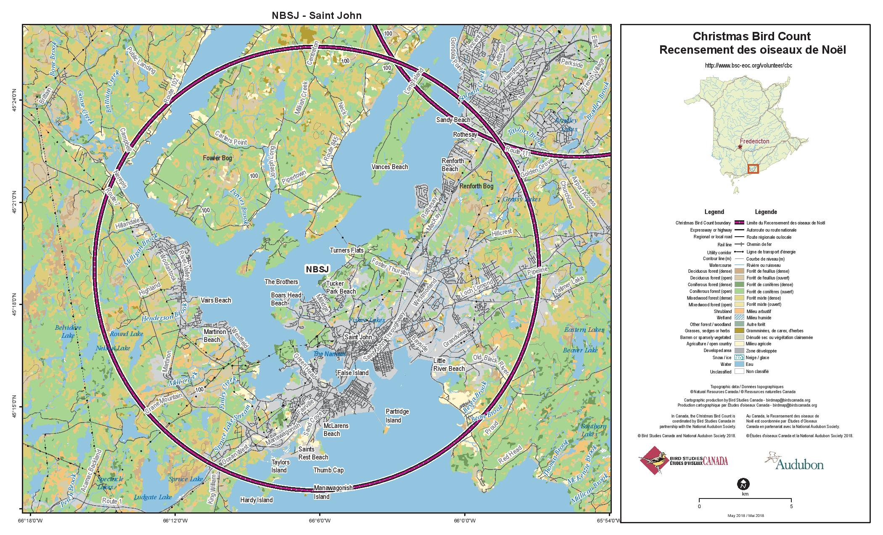
70 years of Saint John Christmas Bird Count data now available in digital form suitable for analysis

Slide 2
Up to now….
Data has been “somewhere”
Locked up in pdfs
Maybe not meaningful
Different observers
Different efforts
….inconsistent

Slide 3
A Brief History
1945-1946 - Austin Squires, New Brunswick Museum
1956 – Austin started the modern era for the CBC in NB
1957 – 1984 - David Christie, SJ CBC compiler, developed CBC in NB to 50 count circles
1985-2023 – average of 40 participants, 100 hours, 600 km,
-22º to +7º = 10,000 birds from 60 species

Slide 4
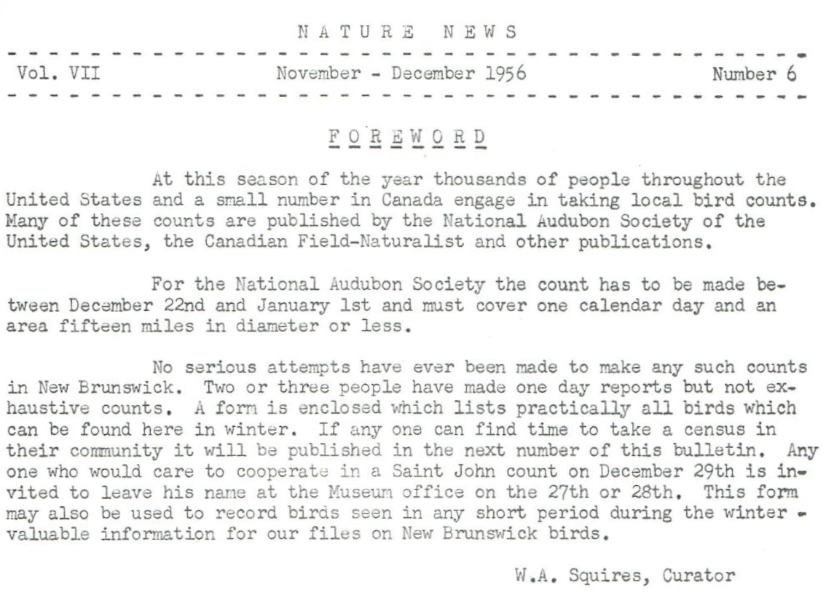
100 columns
by
250 rows

Slide 5
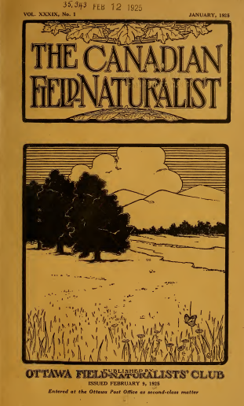
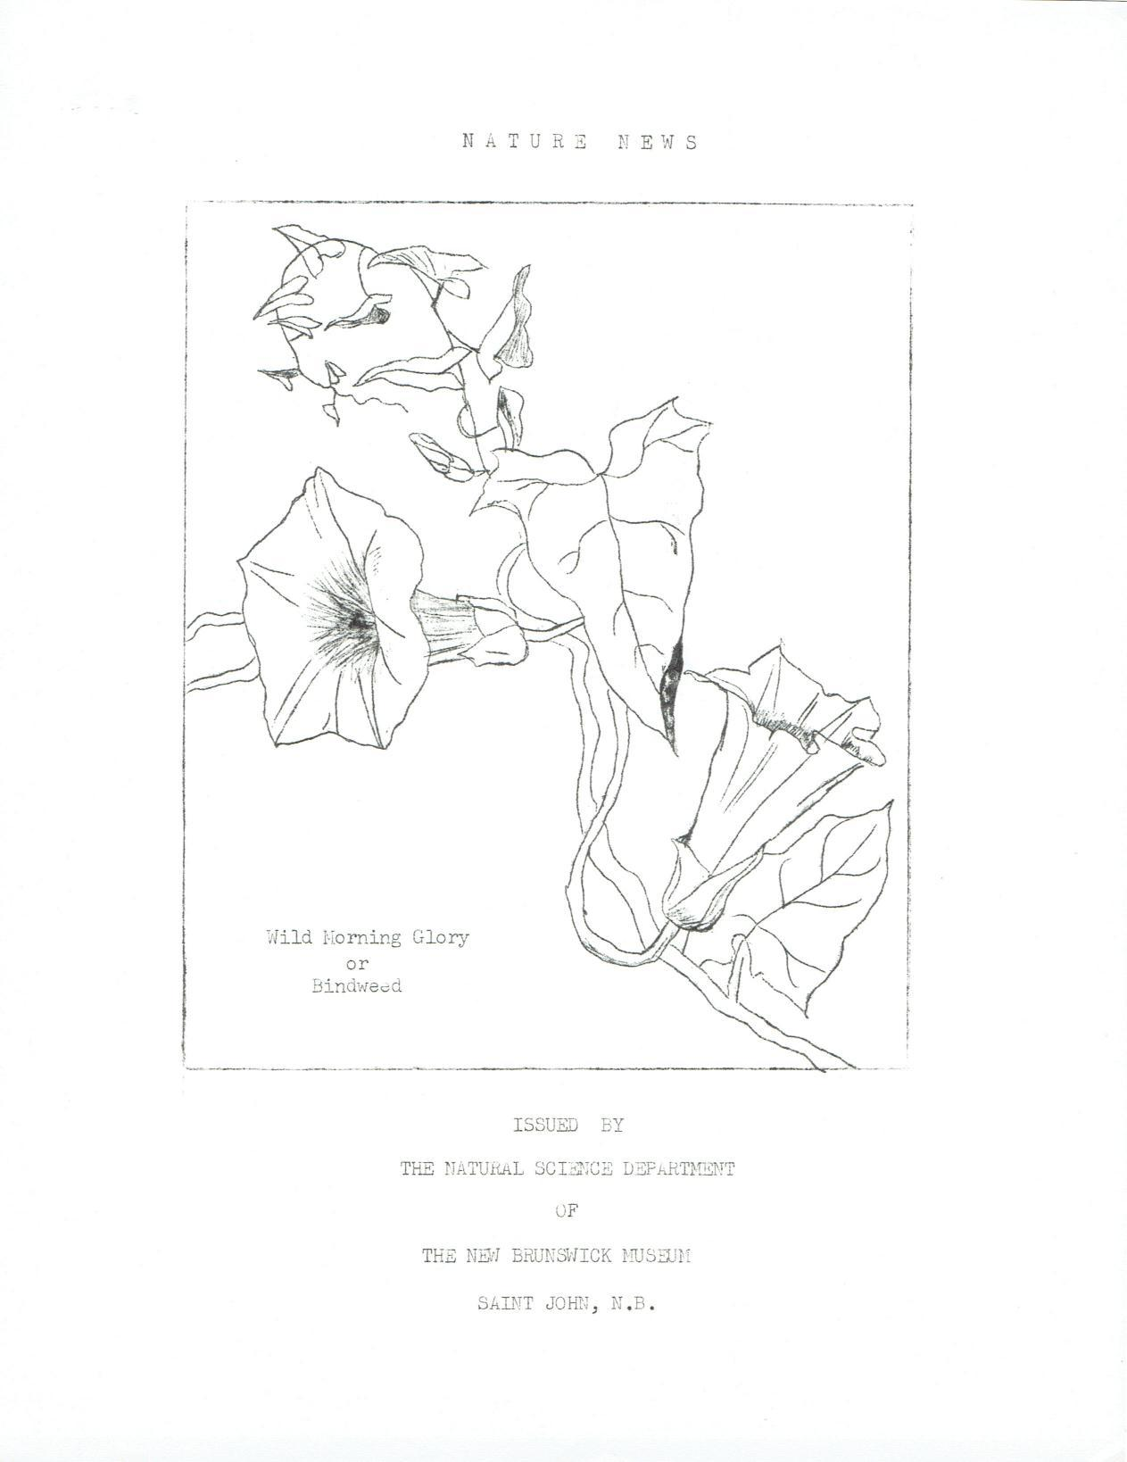
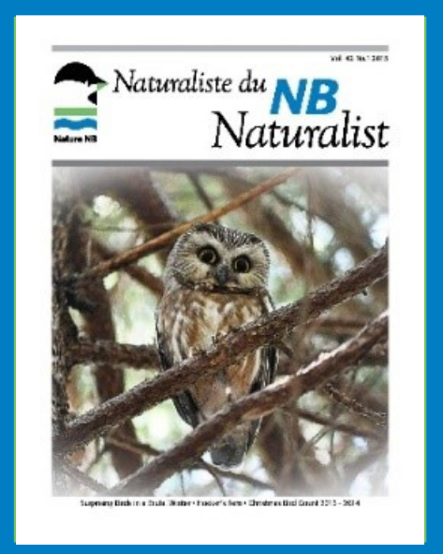
Use Finding Tool at:
https://www.naturenb.ca/publications/nb-christmas-bird-counts/

Slide 6
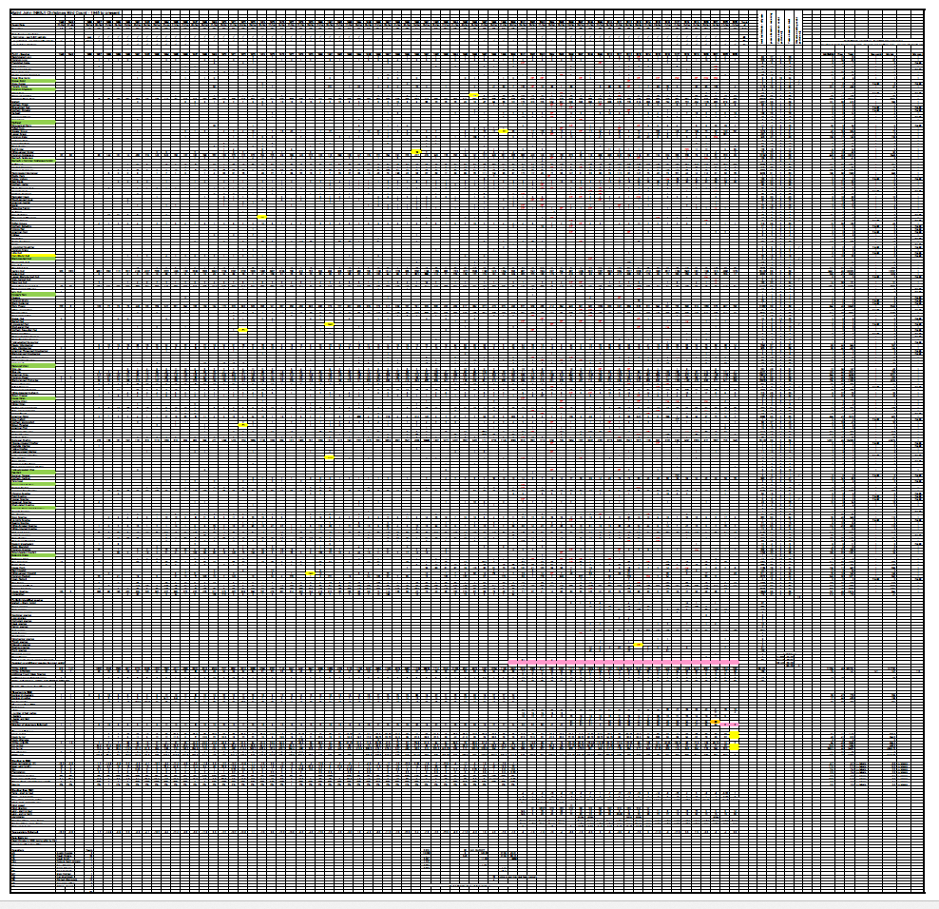
David Christie’s spreadsheet (1945-2000)
100 columns
by
250 rows = 25,000 cells

Slide 7
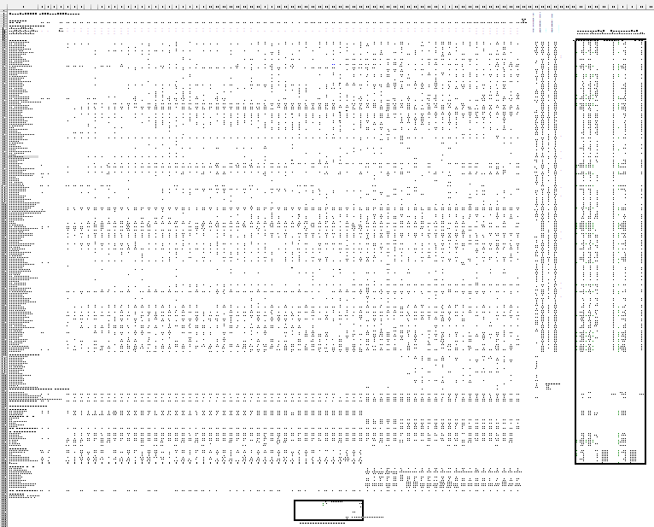
The new spreadsheet
(1945-2023)
A Tour of the Spreadsheet

Slide 8
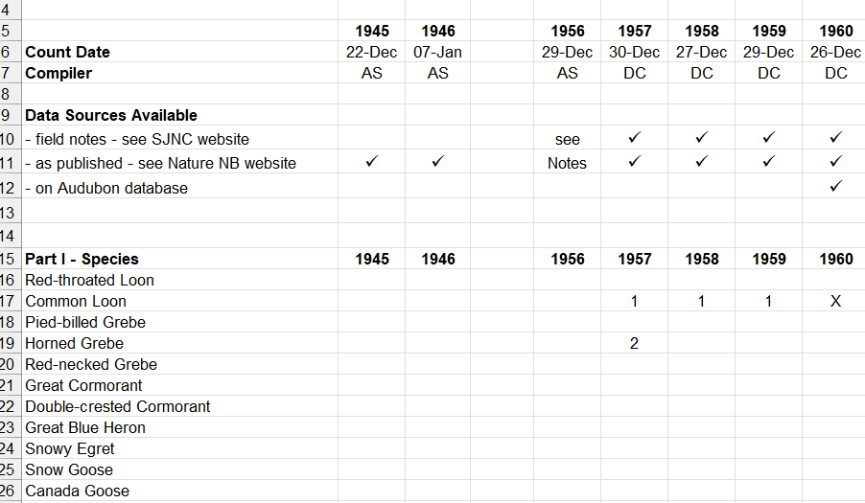
Year, count date, compiler, species

Slide 9
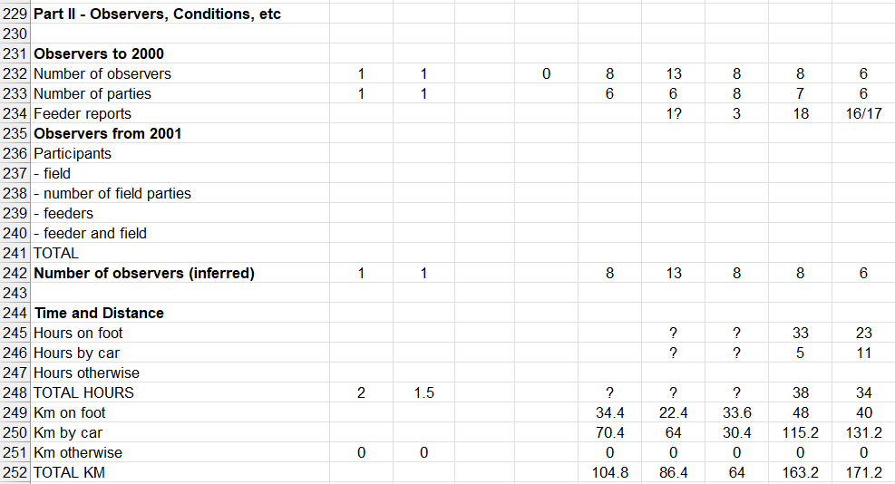
Observers, hours, kms

Slide 10
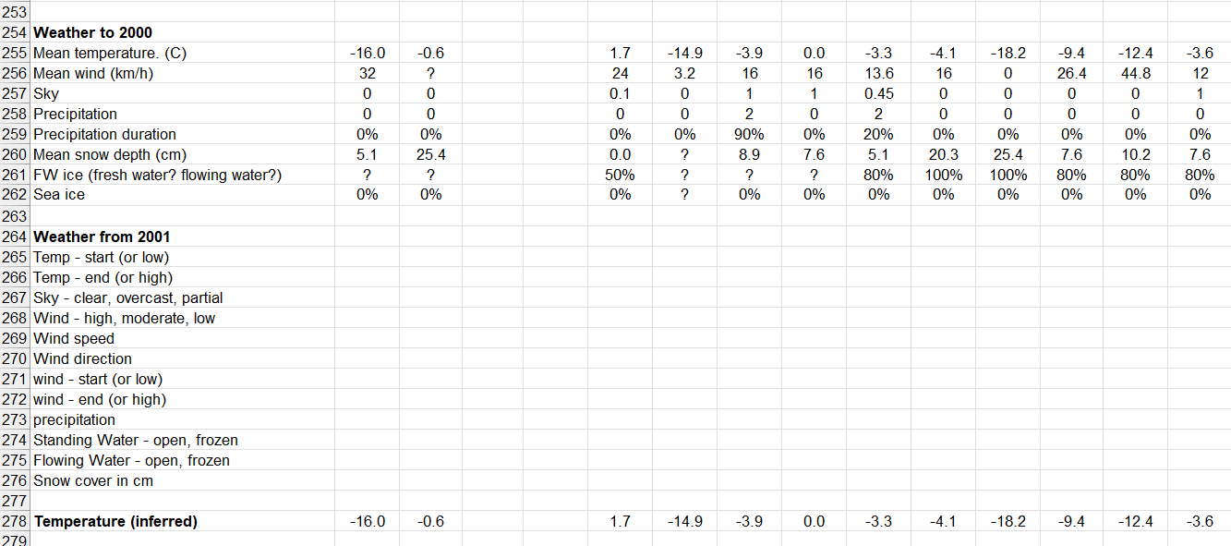
Weather – to 2000 and after 2000

Slide 11
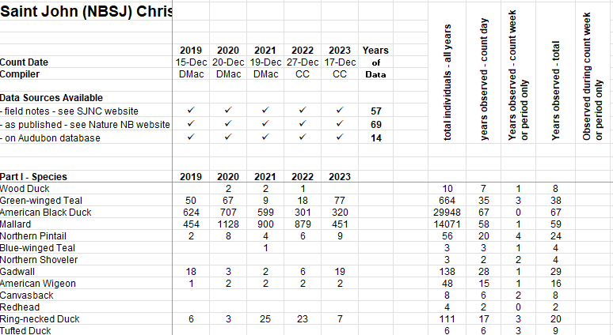
Species total and frequency

Slide 12
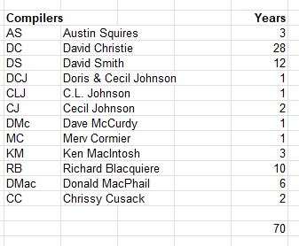
70 Years of Compilers

Slide 13
Data Sources

Slide 14
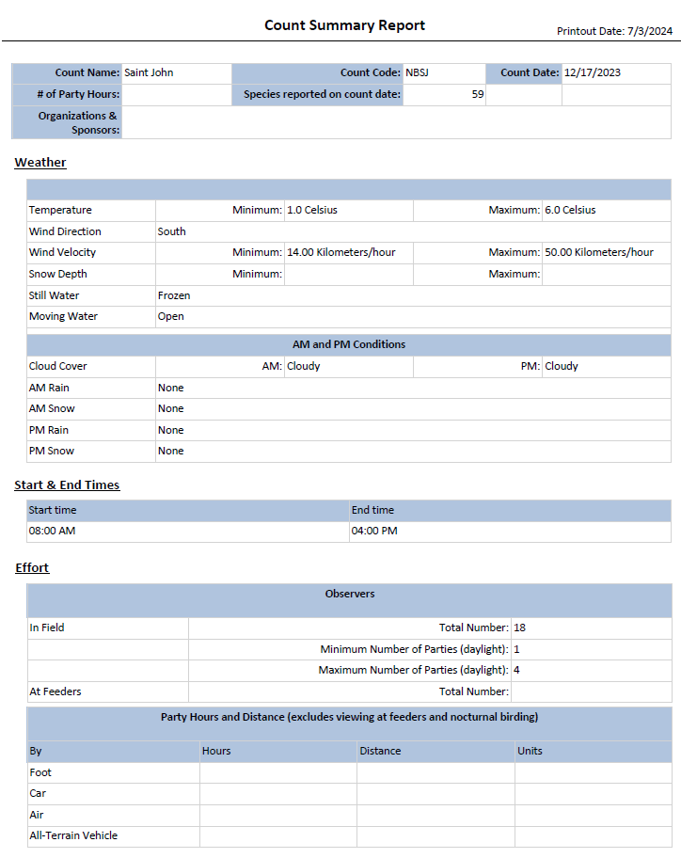
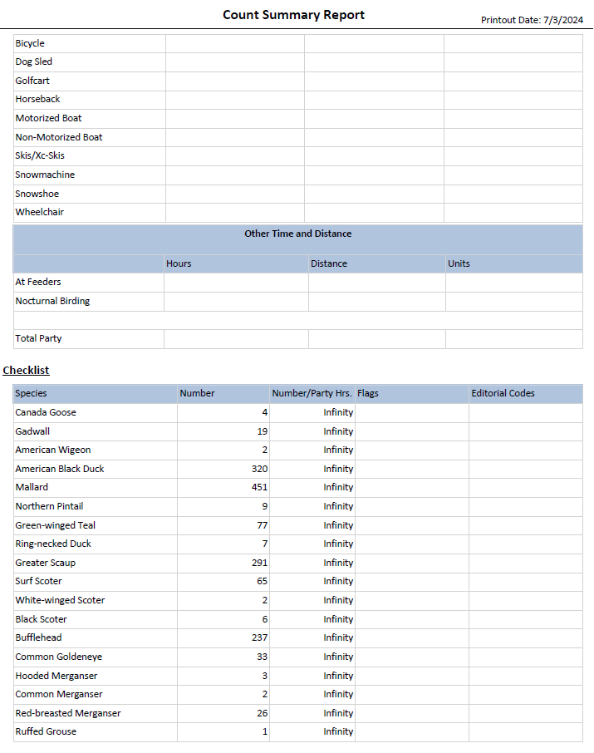
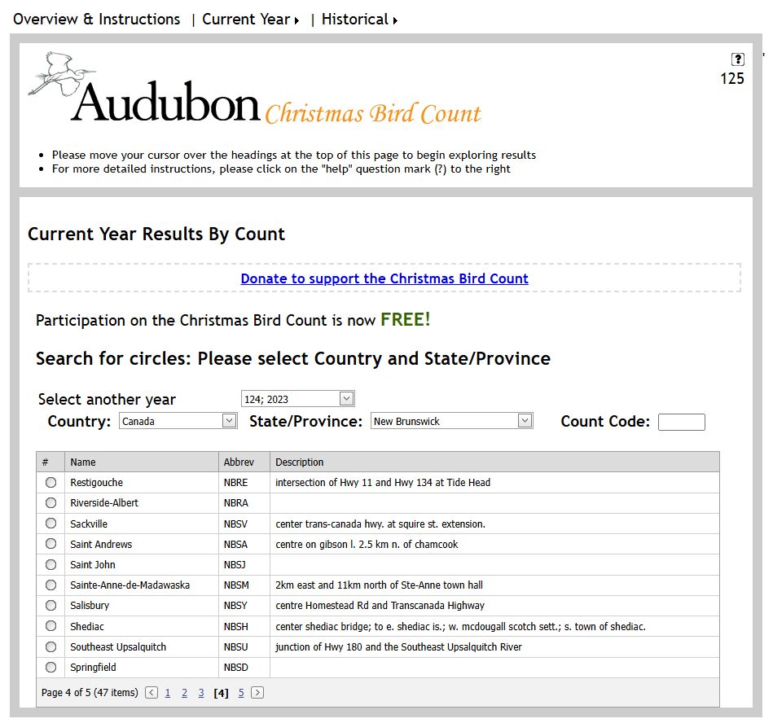
Audubon Database

Slide 15
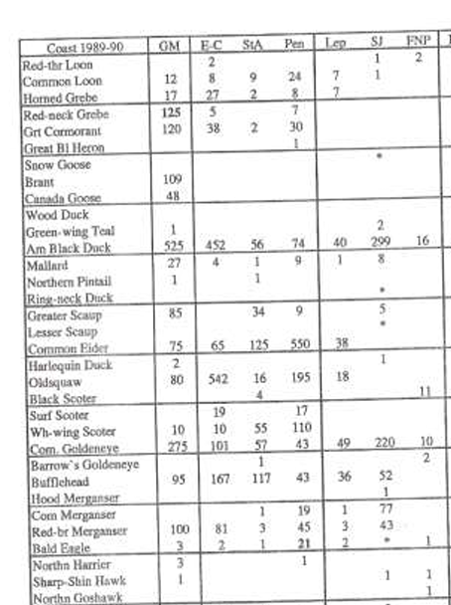
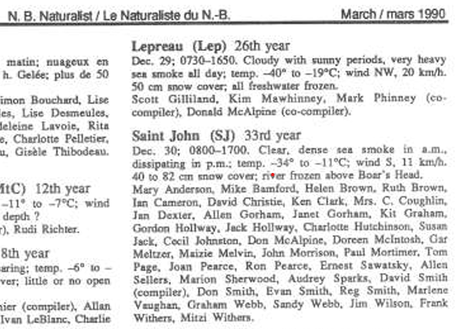
Published Reports

Slide 16
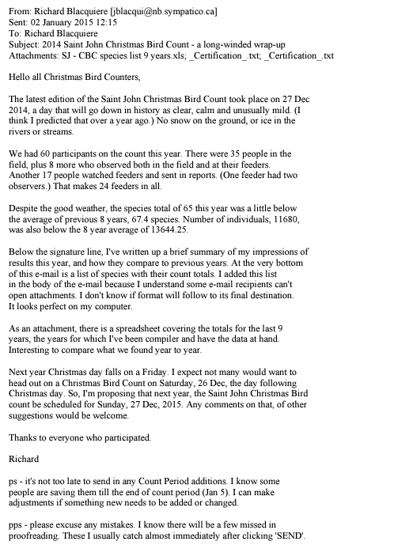
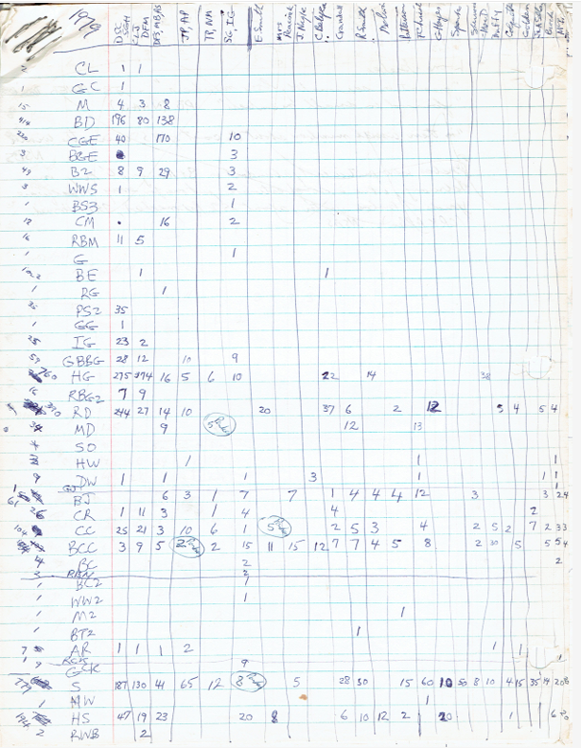
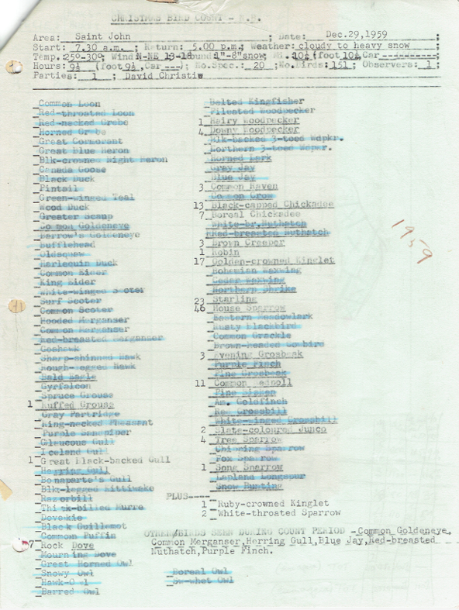
Field Reports
(examples from 1959, 1979 and 2014)

Slide 17
A Look at the Data

Slide 18
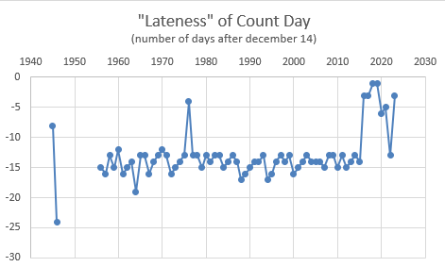

Slide 19
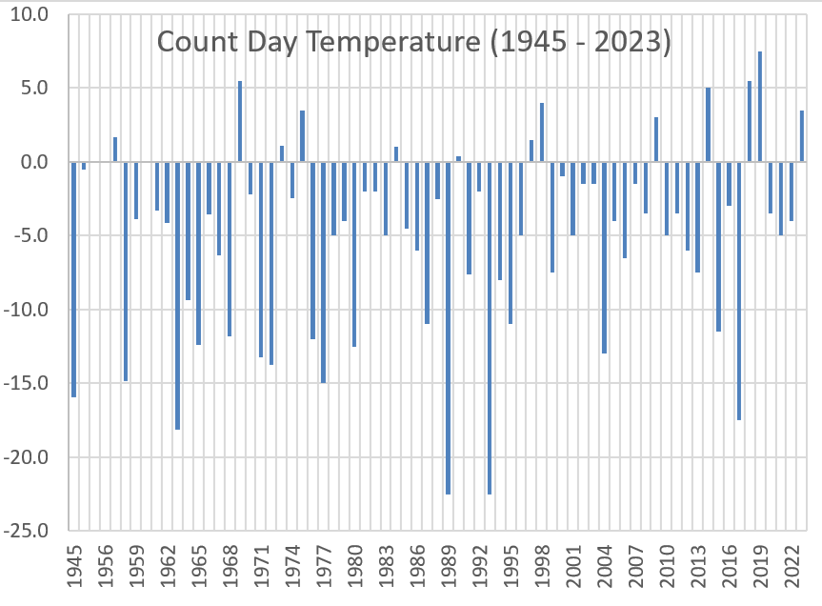

Slide 20
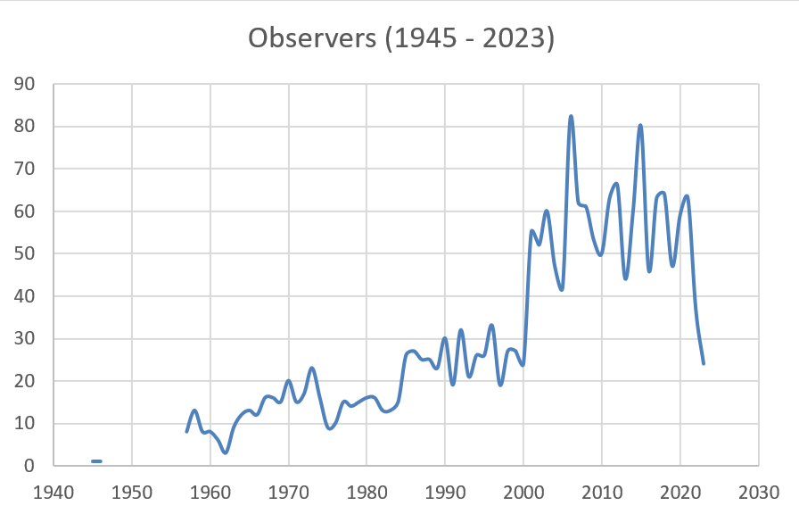

Slide 21
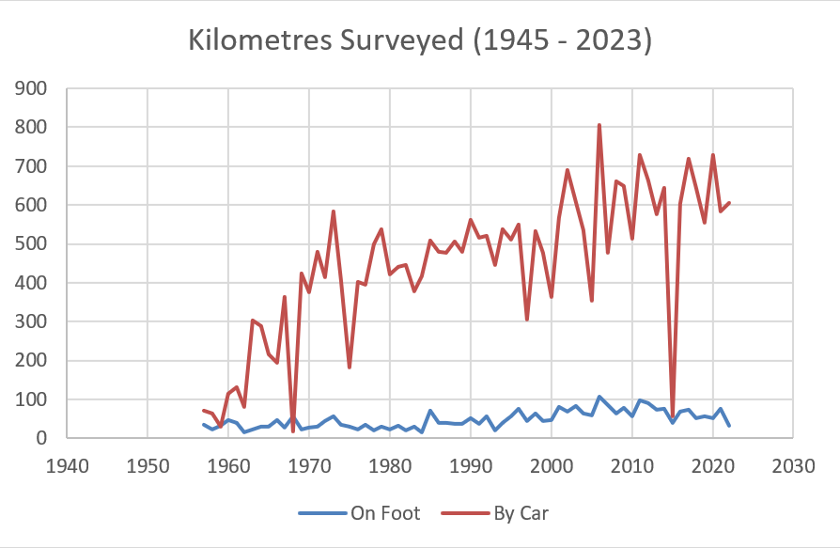

Slide 22
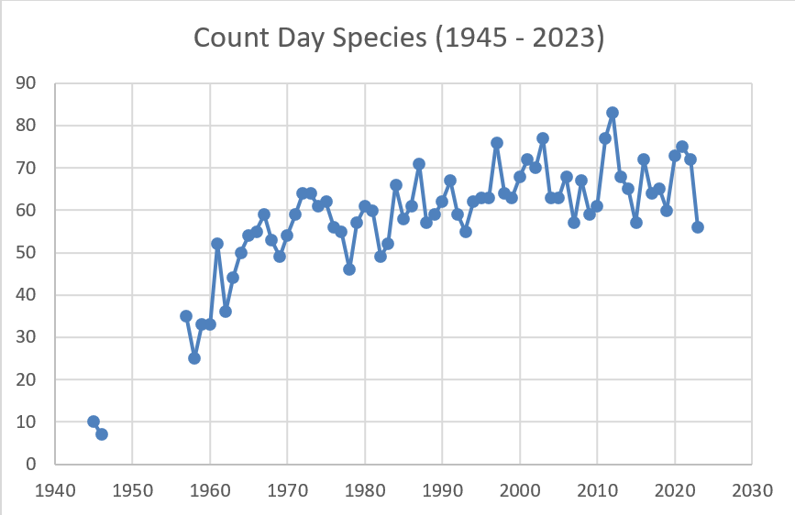

Slide 23
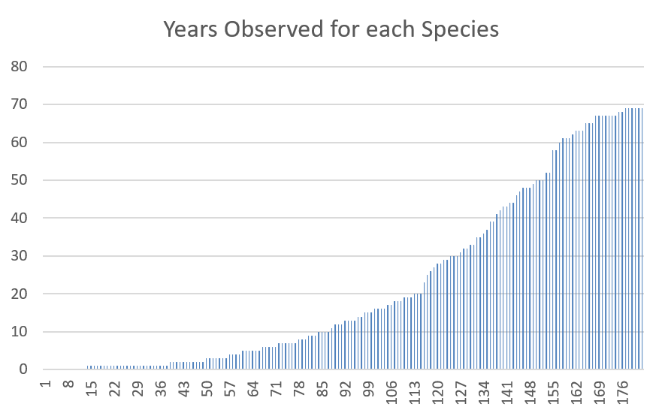

Slide 24
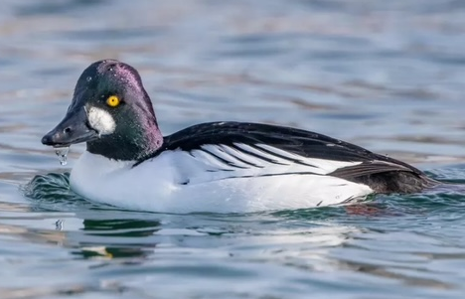
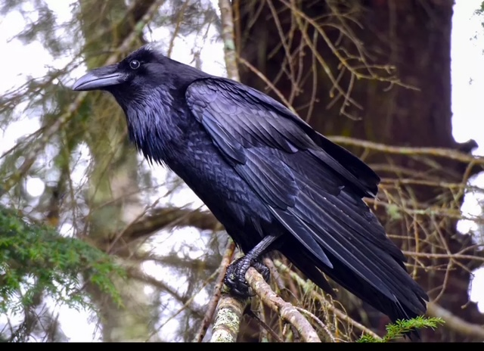
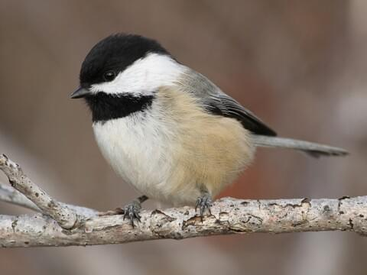
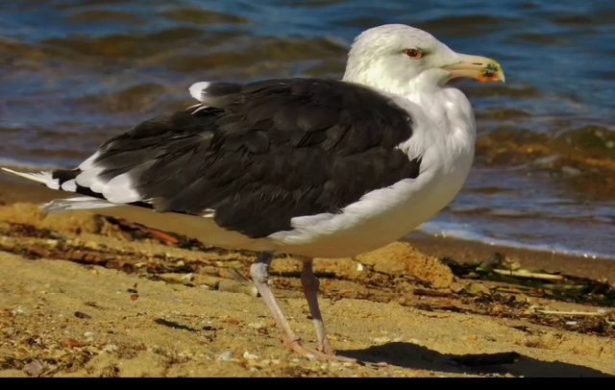
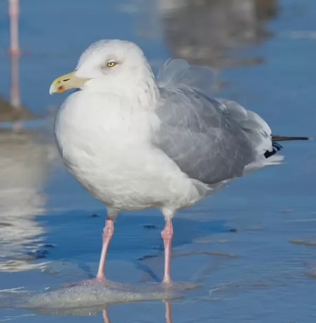
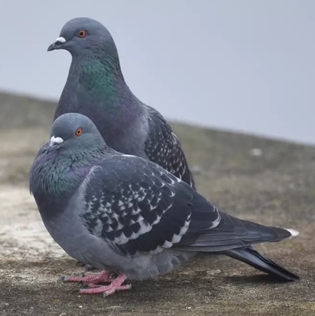
Six Species with Perfect Attendance

Slide 25
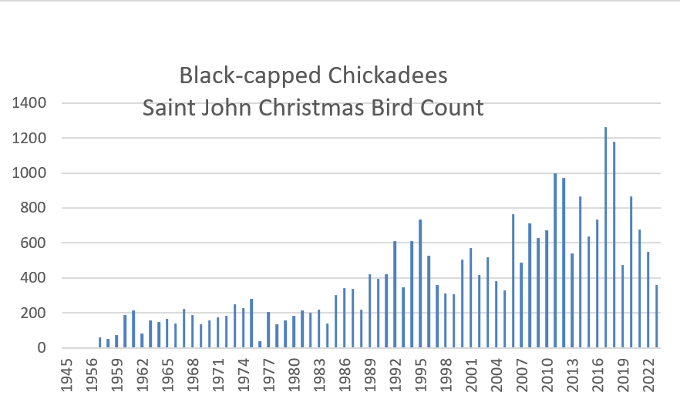

Slide 26
I Year Only Birds
Snowy Egret
Common Shelduck
Virginia Rail
Sanderling
Dunlin
Long-billed Dowitcher
Little Gull
Black-headed Gull
Slaty-backed Gull
Ivory Gull
Forster's Tern
Common Murre
Black Guillemot
Long-eared Owl
Red-headed Woodpecker
Red-eyed Vireo
House Wren
Nashville Warbler
Yellow Warbler
Yellow-throated Warbler
Palm Warbler
Ovenbird
Summer Tanager
Green-tailed Towhee
Field Sparrow
Vesper Sparrow
Seaside Sparrow
Bullock's Oriole

Slide 27
5-10 Year Birds
Short-eared Owl
Northern Saw-whet Owl
Black-backed Woodpecker
Winter Wren
Brown Thrasher
American Pipit
Yellow-breasted Chat
Dickcissel
White-crowned Sparrow
Eastern Meadowlark
Rusty Blackbird
Pied-billed Grebe
Red-necked Grebe
Wood Duck
Canvasback
Tufted Duck
Cooper's Hawk
Gray Partridge
Ring-necked Pheasant
American Coot
Common Snipe
Bonaparte's Gull
Black-legged Kittiwake

Slide 28
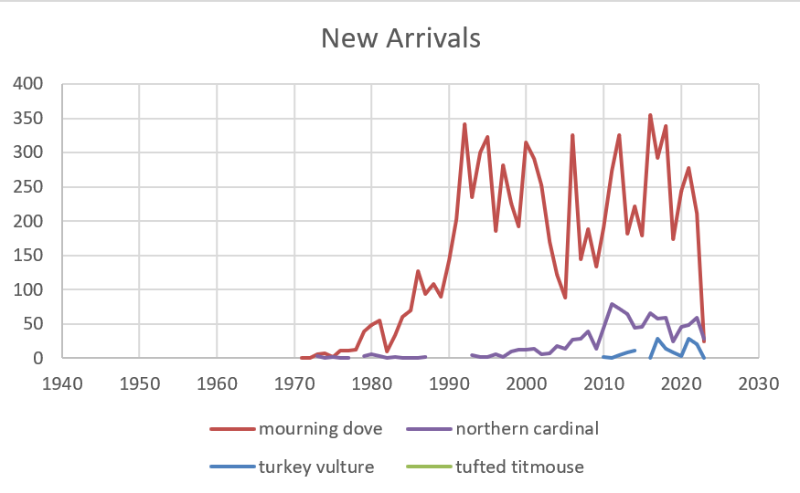

Slide 29
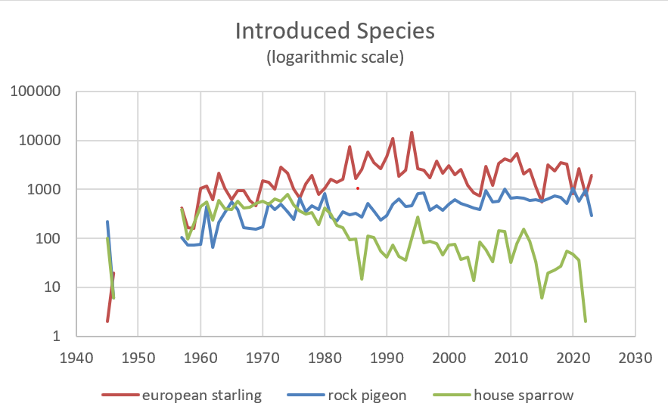

Slide 30
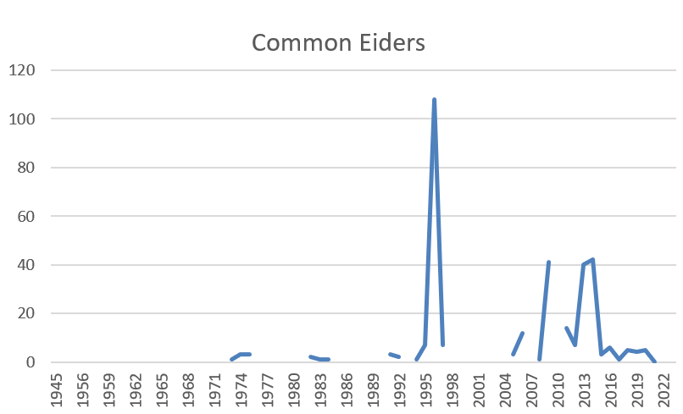

Slide 31
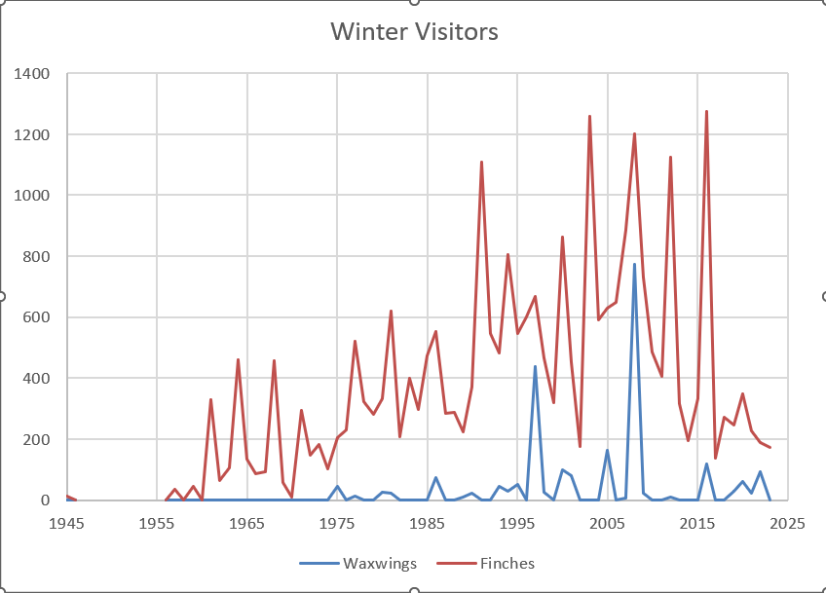

Slide 32
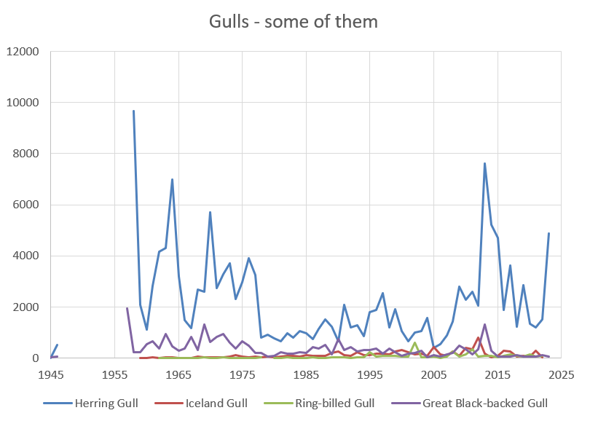

Slide 33
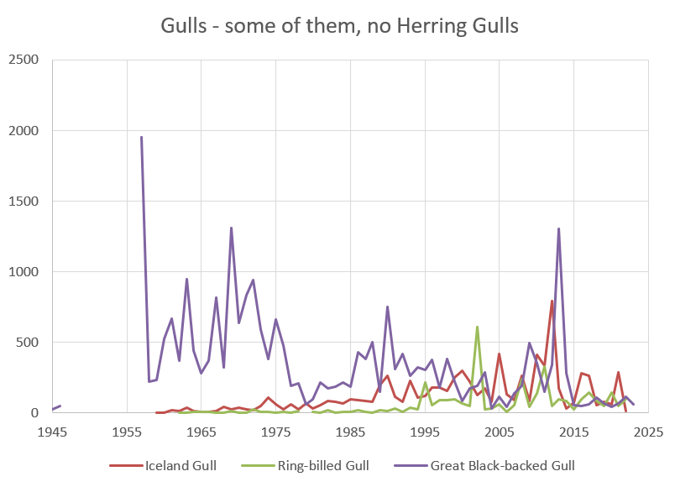

Slide 34
Mystery Species
“Com Blk-hd Gull”

Slide 35
Data Acknowledgements
Audubon – runs the international database
Birds Canada – operates the CBC in Canada
Nature NB – publishes NB CBCs and provides access to all NB CBCs
Saint John Naturalists Club – hosts 70 years of CBC field data and encourages participation
2000+ volunteer observers acquired the data

Slide 36
The 2024 Saint John Christmas Bird Count
will be held on
Saturday December 28
See you there!
Prepared by
Donald MacPhail
December 1, 2024

